Slide 1

Overview of ProQuest Resources for Research and Learning
Supporting Business Students on Their Path to Success
Srijith Sasidharan

Slide 2

Customer Success Manager, APAC
Srijith Sasidharan
training@proquest.com

Slide 3

Session Objectives
At the end of the session, you will be able to:
Understand the key features and capabilities of ProQuest One Business.
Apply ProQuest One Business to conduct market research and competitive analysis.
---------------------------
Analyze data from ProQuest One Business into comprehensive business report.

Slide 4
Session Objectives
At the end of the session, you will be able to:
Understand the key features and capabilities of ProQuest platforms.
Apply ProQuest resources to conduct market research and competitive analysis.
---------------------------
Analyze data from ProQuest into comprehensive business report.

Slide 5

Common activities in Business Schools
Researching a Business Problem
Working on a Project
Case Study
Writing a Business Plan
Company Search
Industry Search
Developing a Marketing Strategy
SWOT Analysis
Competitive Landscape
Marketing Channels
Preparing for a Job Interview
Company Search
Latest Updates
Ebook to brush up Management concepts
Teaching & Lecture Planning

Slide 6
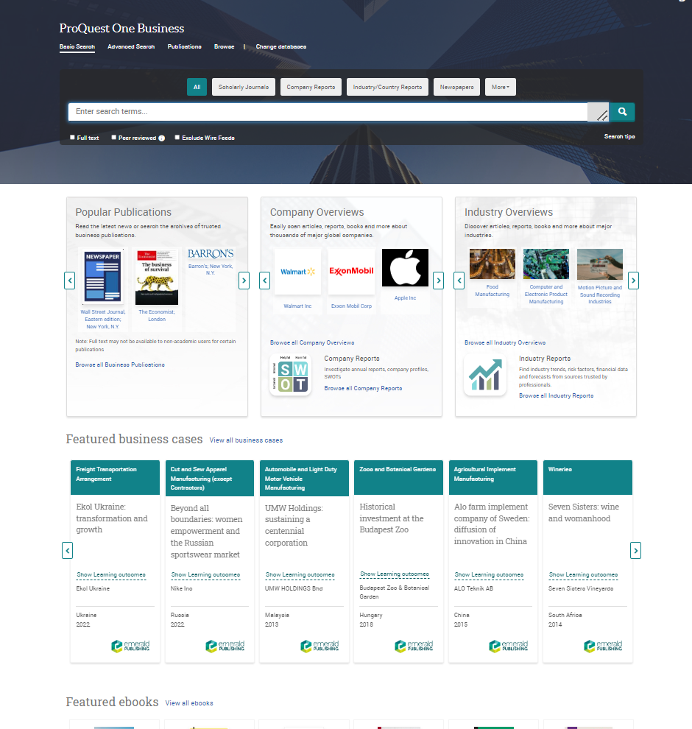
ProQuest One Business
Meeting the unique needs of business students, teachers, and researchers
Developed in collaboration with faculty, students and business librarians, ProQuest One Business delivers a mix of practical and theoretical content in an interface that helps students build the research skills they’ll need for success in their courses and careers.
Key Benefits:
Built on a unique, business-specific interface helps students find the information they need for common assignments with support. Includes the AI-powered ProQuest Research Assistant
Contains authoritative multi-format content including scholarly journals, business news, market & industry reports, analyst reports, books, videos, cases studies and more
Includes unique discipline features such as Topic Pages for 4k global companies and 119 NAICS codes, and business-specific thesauri
Key Topics:
At-a-glance
Accounting & Tax
Banking
Business Law
Economics
Entrepreneurship
Finance
Human Resources
Management
Marketing
2,900 Full-text Scholarly Journals | 21k Videos | 29k Books | 130 News Sources | 30k Case Studies & Business Cases | Thousands of Reports | 2,500 Magazines & Trade Journals | 55k Dissertations

Slide 7








Full-Text Content Includes:
Scholarly Journals
News
Magazines
Market, Country, Industry & Analyst Reports
The latest and most important academic thought from over 2,900 journals
Over 130 news sources including Financial Times and Wall Street Journal
Information and trends from over 2,500 magazines and Trade Journals including The Economist
Thousands of reports from providers including EIU, J.P. Morgan, Fitch Solutions, and Plunkett
Business Cases &
Case Studies
Books
Videos
Dissertations
More than 30,000 allow students to see complex issues in their real-life context
Over 29,000 ebooks allow users to dig deep into topics
21,000 videos including practical ‘how to’ guides, insights from business leaders, and more.
Unique insight from over 55,000 dissertations and theses

Slide 8






Important Scholarly Publishers
Over 2,600 full-text scholarly journals from publishers such as
Notes:
Palgrave, Sloan, Emerald are exclusive; many Springer and CUP titles are unique.

Slide 9

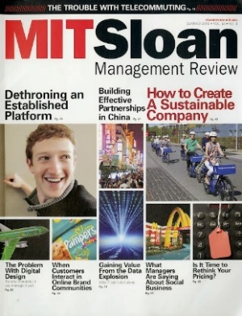






Key Scholarly Titles
Including
Done

Slide 10











Essential Business Magazines and Newspapers
Notes:
Business press helps researchers identify the hot topics in their area, which makes it easier to get published.
Researchers also need to keep on top of the current news in and around their subject areas.

Slide 11




The Latest Thinking First
First-released working papers, dissertations, conference papers can take 3+ years to get into scholarly journals or books
Working Papers
Over 550K with full text links
Dissertations
Over 50K in full text
Conference proceedings
25K in full text

Slide 12










Global Newsstream
Premier current news coverage with 40+ years of backfile
Researchers gain full-text access to nearly 2,000 sources from ProQuest's U.S., Canadian, and International Newsstream collections, including newspapers, newswires, broadcast transcripts, and websites, with an extensive archive reaching back to the 1980s, providing valuable historical context for their research.
Explore hundreds of U.S. and Canadian major dailies including The New York Times, The Wall Street Journal and Globe and Mail alongside leading international titles such as The Guardian, Le Monde, The Times of India and The Age.
    Extensive coverage across digital, print, and video news sources.
    Video sources are increasingly important to educators and researchers.
        Watch The New York Times and Washington Post video, and CBS 60 MINUTES segments
    Leverage ProQuest Research Assistant, an AI-powered tool that identifies document takeaways and suggests next research steps, plus detailed indexing, citation tools, and multilingual translation options.

Slide 13






Academic Complete
The foundational ebook subscription for academic excellence
Academic Complete is ProQuest’s flagship subscription database trusted by libraries around the world. For more than two decades, students have relied on Academic Complete’s unlimited access, multidisciplinary coverage, and powerful research tools.
242,300+ ebooks hand selected for quality over quantity.
43,400+ fully DRM-free titles.
42,000+ notable and award-winning titles from CHOICE, Library Journal Starred Reviews, RCL, DOODY’s, BKCI.
15,400 in-demand titles from Wiley publishing.
7 catalog enrichment elements for greater discovery and usage.

Slide 14










Academic Complete – 10 Key Subject Areas
Arts
13,600+ Titles
Business
28,900+ Titles
Education
12,900+ Titles
Law
14,800+ Titles
History
44,000+ Titles
Health & Medicine
20,300+ Titles
Literature & Language
32,950+ Titles
Religion & Philosophy
22,100+ Titles
Science & Technology
44,000 Titles
Social Science
43,000+ Titles

Slide 15
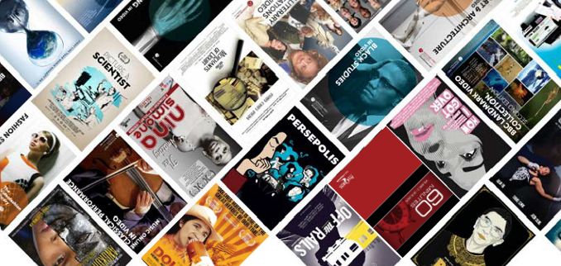




Academic Video Online
The most complete streaming video resource to support teaching and learning through an immersive visual experience
With more titles (~85,000*) than any other video provider, including 21,000*+ exclusive videos, Academic Video Online delivers unlimited access to the most comprehensive video solution available at a predictable annual cost.
Broad subject coverage across the disciplines.
Continuously growing list of providers and films to adapt to today’s demanding video needs, with ~3,500 added annually.
~85,000* videos from award-winning filmmakers, producers and media companies.
Includes transcript interaction, captions, and on-demand audio description. Stand-alone also provides video interaction, clip-making and playlist functionalities.
*Territory restrictions apply

Slide 16












 | A+E Networks®
 | Academic Video Online* includes documentaries, feature films, interviews, performances, news programs and newsreels, tutorials, demonstrations, and more. These sources are frequently used for classroom instruction. |  | Giant Pictures Monument Releasing California Newsreel Music Box Films Grasshopper Film |  | Juno Films Collective Eye Cinema Guild Pragda The Video Project
 | WSJ |  |  | Annenberg Learner
The George Balanchine Foundation
Association for Supervision & Curriculum Development ASCD
*Territory restrictions apply

Slide 17





PQ Dissertations & Theses Global
Uncover the undiscovered: Open a world of cutting-edge research for your students and scholars
Vast global network
With 6M+ metadata records including 3.6M+ full text documents, PQDT Global is the world leader in providing access to dissertation and thesis research.
PQDT Global provides:
Ways to discover emerging topic areas, enhance literature reviews, broaden perspectives and access insights not available in peer-reviewed literature.
Global coverage: Records from North America, Europe, Asia, to Africa and beyond deliver a global view of the research landscape.
The integration of PQDT Global and the Web of Science™ seamlessly uncovering early career, post-graduate research alongside journal articles, conference proceedings, research data, books, preprints and patents.
A unified search experience for comprehensive metadata, citations and full text for graduate dissertations and theses not available anywhere else.
Over 6 Million
Records
3.6M+
Full text
4,100+
Universities
70+
Countries
300,000+
Records added yearly

Slide 18
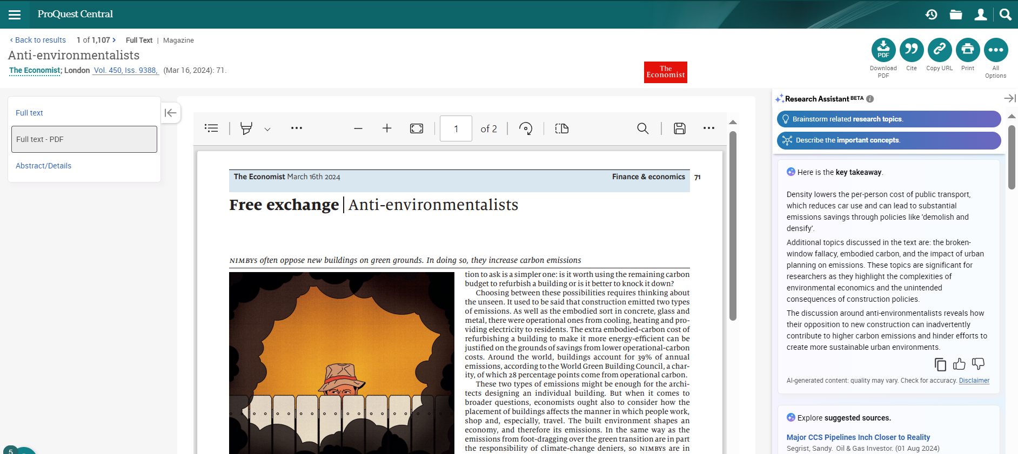
ProQuest Research Assistant
Harnesses AI’s powerful capabilities and applies them in a responsible, reliable manner as a research companion for students.
Easily craft more effective and targeted searches
More effectively review, analyze, and interrogate documents
Quickly evaluate the usefulness of each document for your research
Get guidance on next steps like choosing a research topic and understanding key concepts in the document
ProQuest One Academic

Slide 19
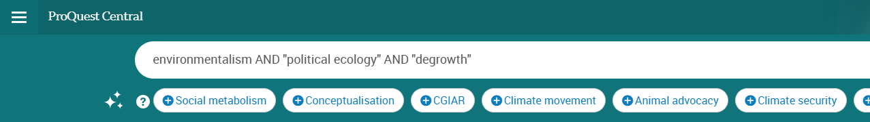
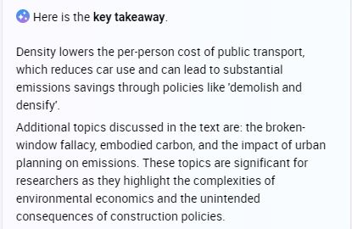
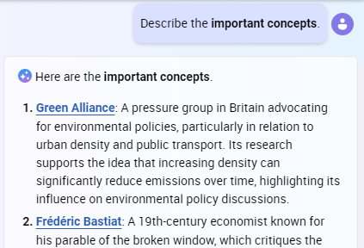
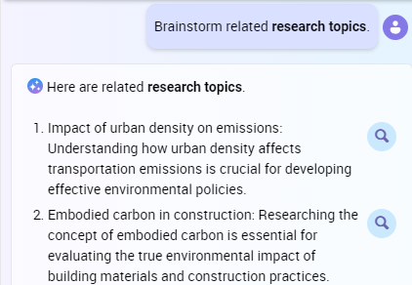

Generates synonyms and related terms to help users easily craft a structured Boolean search, adding relevant terms with a click
ProQuest One Academic
Insights are customized to the document being viewed, including a key takeaway to quickly determine relevance
Users are guided to useful next steps such as exploring the key concepts discussed in the document…
…or choosing from suggested research topics based on the document

Slide 20
Demo

Slide 21
Additional Resources
LibGuide: https://proquest.libguides.com/pq1business/
Product information: https://about.proquest.com/products-services/ProQuest-One-Business.html
For more training contact us at training@proquest.com
Notes:
Additional Resources

Slide 22

Feedback
Thank you so much for joining. Please type the URL to share your valuable feedback and comments about the session:
https://tinyurl.com/sx7dhk3w
Srijith S
srijith.sasidharan@clarivate.com
+91 9632916297

Slide 23
Thank you
Questions?
training@proquest.com

